Slide 1
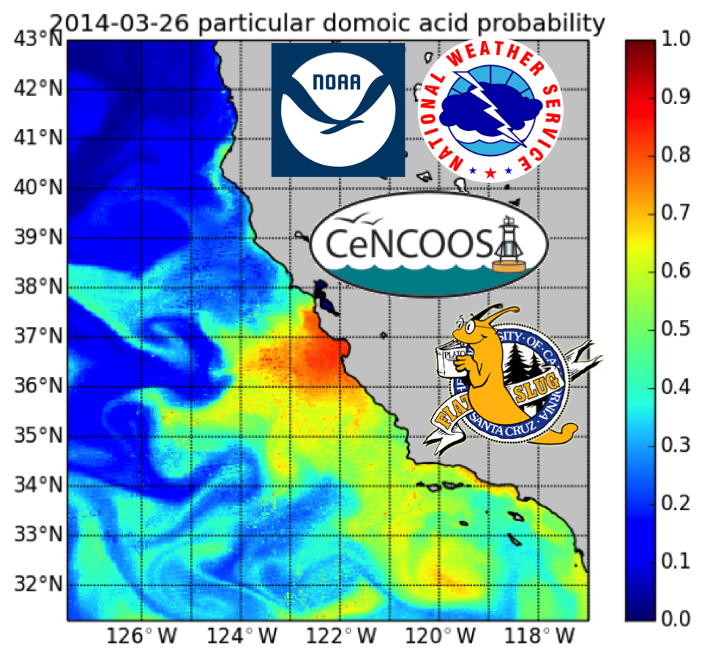
Merging Satellite and Numerical Model Data in the California Current to Create Continuous Imagery and
Forecasts of Harmful Algal Blooms
Clarissa R. Anderson¹, Raphael M. Kudela¹, Leslie K. Rosenfeld²,
Mati Kahru³, Yi Chao⁴, Dale H. Robinson⁵, Richard P. Stumpf⁶
¹University of California Santa Cruz
²Central & Northern California Ocean
Observing System (CeNCOOS)
³Scripps Institution of Oceanography
⁴UCLA-JIFRESSE/RSS Inc.
⁵NOAA CoastWatch, West Coast Node
⁶NOAA National Ocean Service
Biodiversity and Ecological Forecasting Team Meeting
23 April 2015
NASA Science Mission Directorate, Earth Science Division, Applied Sciences Program
“Ecological Forecasting for Conservation and Resource Management”

Slide 2
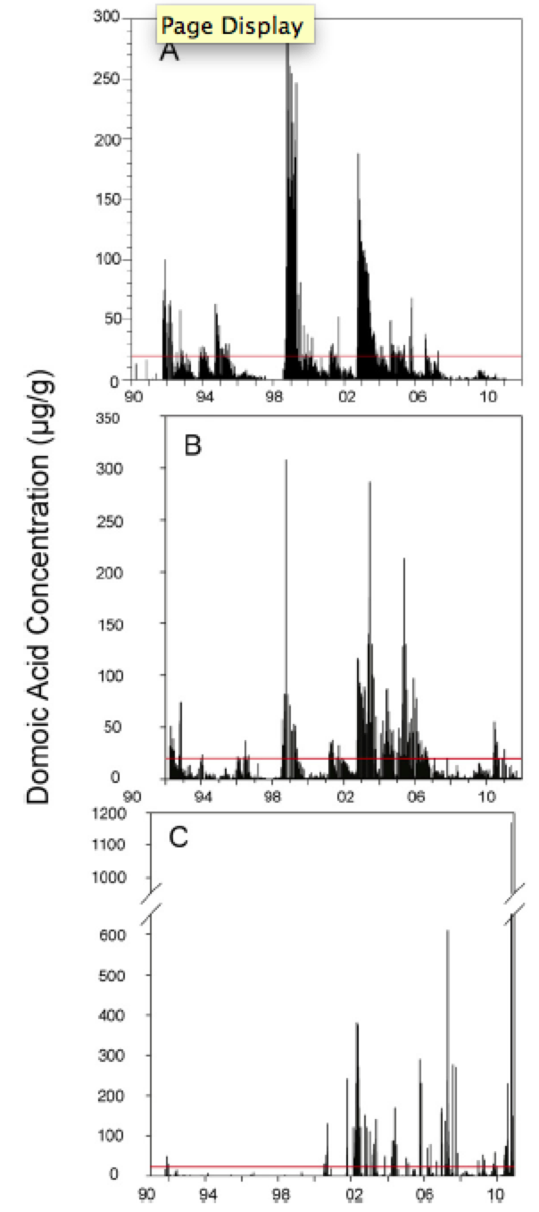
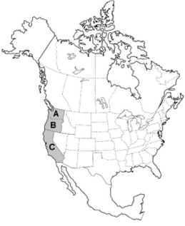
SIGNIFICANCE OF THE PROBLEM
Forecasting HABs in the California Current - SIGNIFICANCE
Washington
• Domoic Acid from the diatom Pseudo-nitzschia is a serious health and ecosystem risk– and is identified as the leading HAB issue on the US west coast. Lewitus et al. 2012
• While not always linked to water quality, there is evidence that toxicity responds to anthropogenic nutrients
Anderson et al. 2008; Howard et al. 2007; Kudela et al. 2008; Kudela et al. 2010
Potential to harm marine mammal
populations over the long term
Jensen et al. 2015
• Despite the wealth of research
programs that directly and indirectly
interface with HAB issues in California,
there is no predictive capability for
HAB events
INITIAL BASELINE FOR DECISION MAKING
-Monitoring in real-time at low spatial resolution
Relies primarily on the presence of toxin in
shellfish and fixed quarantine periods
Oregon
Lewitus et al. Harmful Algae 2012
California
Year

Slide 3
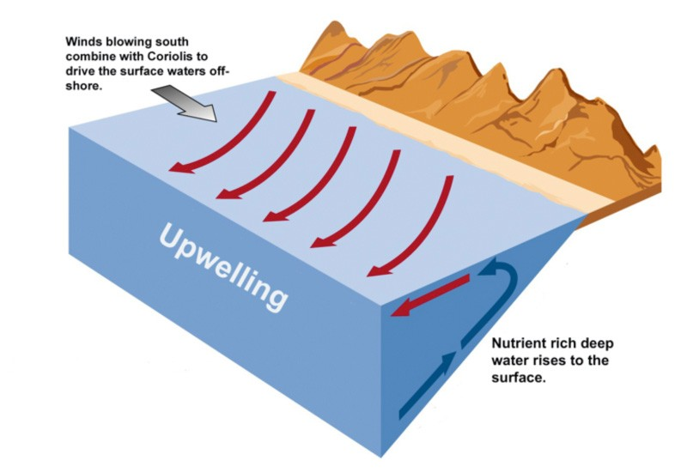
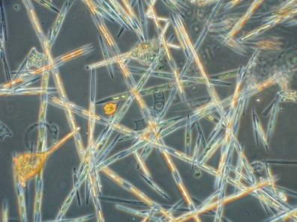
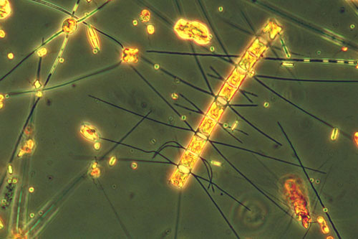
Forecasting HABs in the California Current - SCIENTIFIC CHALLENGES
METHODOLOGY
Empirical models that link the conditions in the water to the likelihood of seeing a bloom of Pseudo-nitzschia and production of domoic acid
Si(OH)₄– DIATOMS
ONLY
Depletion of Si
in the water relative to N and P
NO₃⁻
PO₄²⁻
Si(OH)₄ : NO₃⁻
Runoff from agriculture also has low Si:N
(high nitrate and urea in fertilizers)

Slide 4
Forecasting HABs in the California Current - SCIENTIFIC CHALLENGES
METHODOLOGY
Generalized Linear Model – logistic regression
HAB Variable (Threshold) | Best-fit Logistic GLM P_{bloom} = e^{(λ)}/[e^{(λ)} + 1]
Pseudo-nitzschia (10⁴ cells mL⁻¹) | = 17.0 – 6.18[R_{rs} (510/555)] – 0.237[Si(OH) ₄:(NO₃+NO₂)] – 0.482(Month) – 0.225[Si(OH) ₄:PO₄] - 1266[R_{rs} (510)]
pDA (500 ng L⁻¹) | λ= -154.2 + 0.145[Chl] – 0.968[Si(OH)₄:(NO₃)] – 0.619(Temp) + 4.92(Sal) – 0.555(NO₃)
cDA (10 pg cell⁻¹) | λ= 10.7 – 0.618(Temp) – 0.659[Si(OH)₄]] – 767[R_{rs} (510)]
DOMOIC
ACID
BUT….. We cannot easily acquire these nutrient data in real time or remotely
THUS… we cannot use these models for routine forecasting of DA events
ALTERNATIVE APPROACH:
Build models using physical and bio-optical predictors

Slide 5
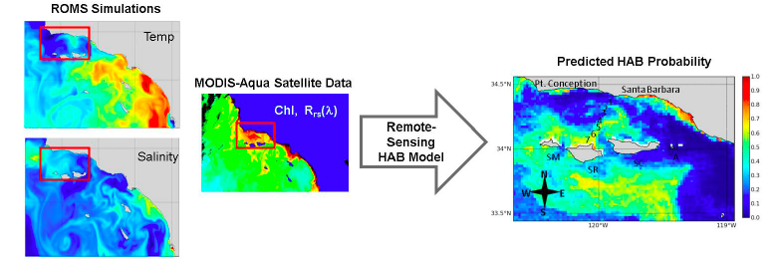
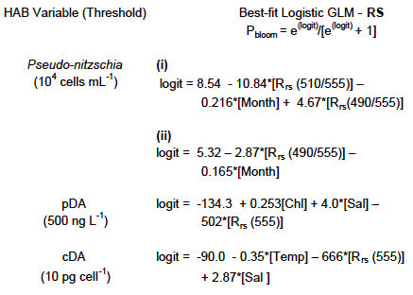
THE APPLICATIONS CHALLENGE
Forecasting HABs in the California Current - SCIENTIFIC CHALLENGES
Remote Sensing Reflectance
Salinity
Temperature
Chlorophyll
Nitrate
Phosphate
Silicic Acid
Anderson et al. 2011, Detecting toxic diatom blooms from ocean color and a regional ocean model. Geophysical Research Letters

Slide 6
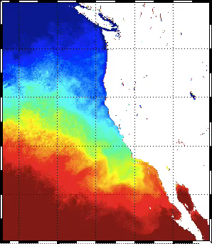
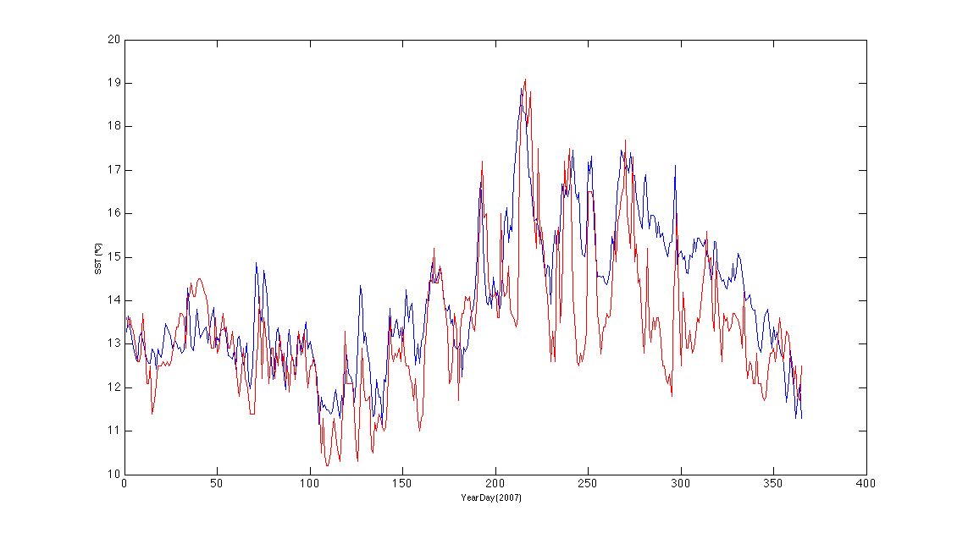
Data Interpolating of EOFs (DINEOF) to deal with gappy satellite data
Forecasting HABs in the California Current - TECHNOLOGY
Blue: MODISA DINEOF
Red: NDBC Buoy
2007 SST Reconstruction
(daily)
(NDBC 46054 West Santa Barbara)
• Statistical reconstruction of satellite data solving spatial and temporal EOFs simultaneously
(Beckers & Rixen, 2003)
• Can use covariance-matrices to solve for multiple linked datasets
• SST: R²=0.9, RMSE < 1°C, as good as Pathfinder AVHRR but daily!

Slide 7
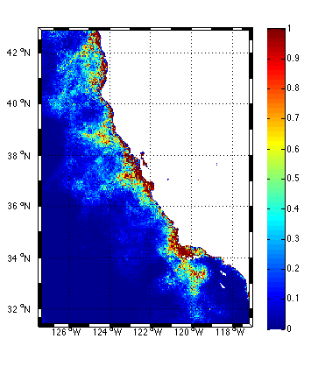
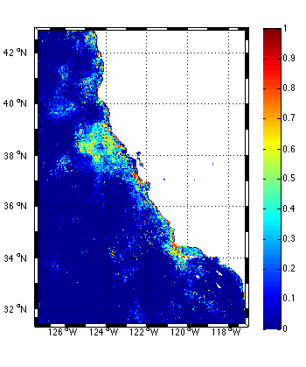
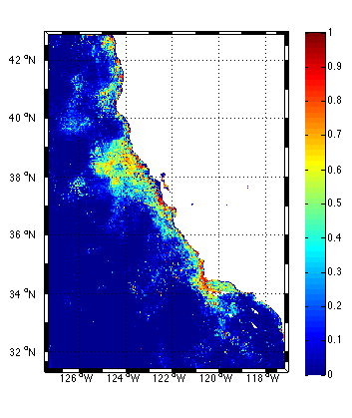
FORECASTING Pseudo-nitzschia USING DINEOF
Forecasting HABs in the California Current - TECHNOLOGY
Hindcast
YD 215
(August)
Forecast
YD 220
Forecast
YD 225
• Predict fields by seeding Rrs, CHL with last 5-day interval
• Solve (DINEOF) using forecast model fields (SST, Salinity) and seeded satellite data
• OR use ROMS current trajectories to advect satellite data forward and then solve
• Reasonable agreement up to 2 time-steps (10 days) forward (also for Rrs, CHL, SST)

Slide 8
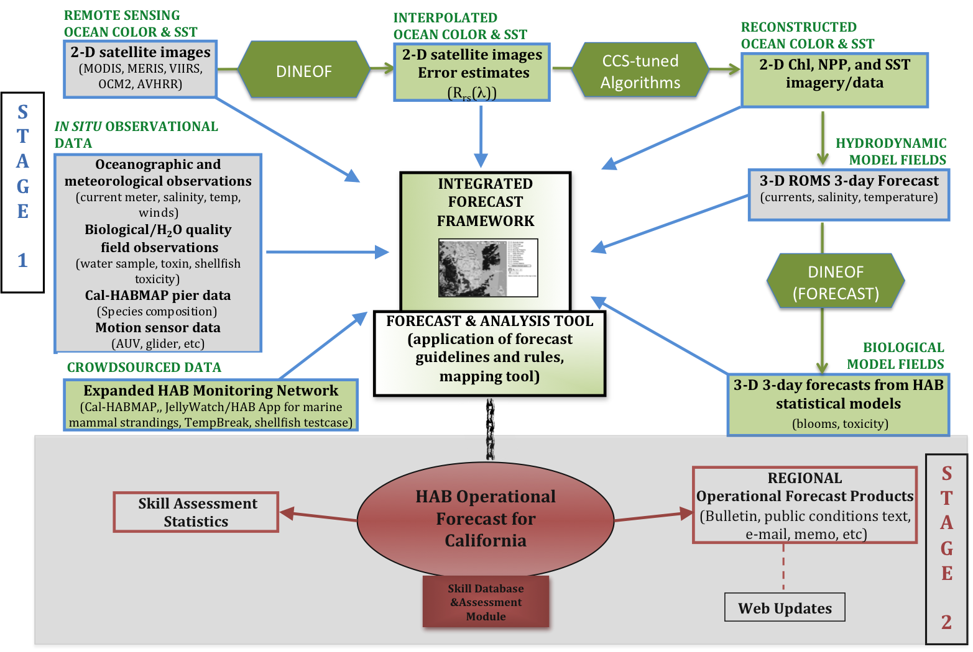
Forecasting HABs in the California Current - FEASIBILITY DEMONSTRATION
2014-2015: PRE-OPERATIONAL DEMONSTRATION PHASE

Slide 9
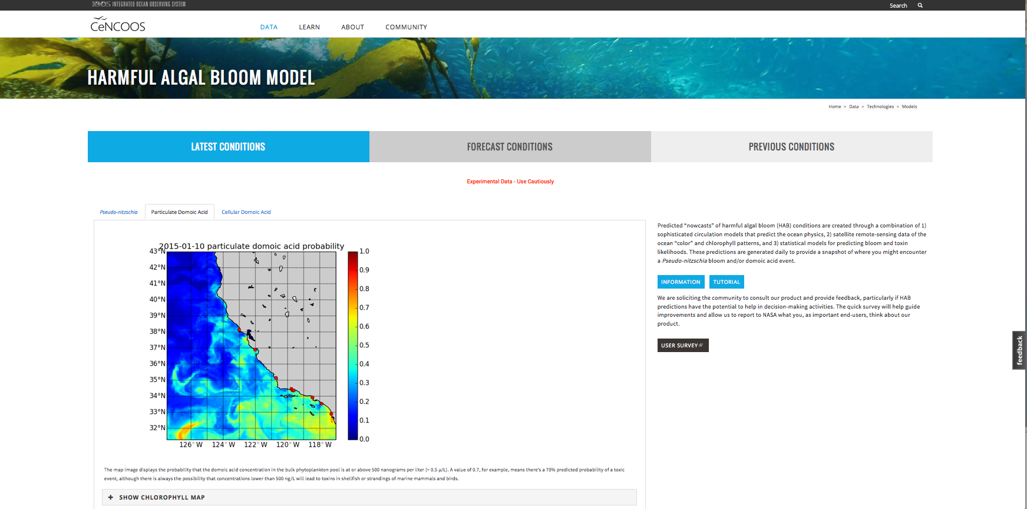
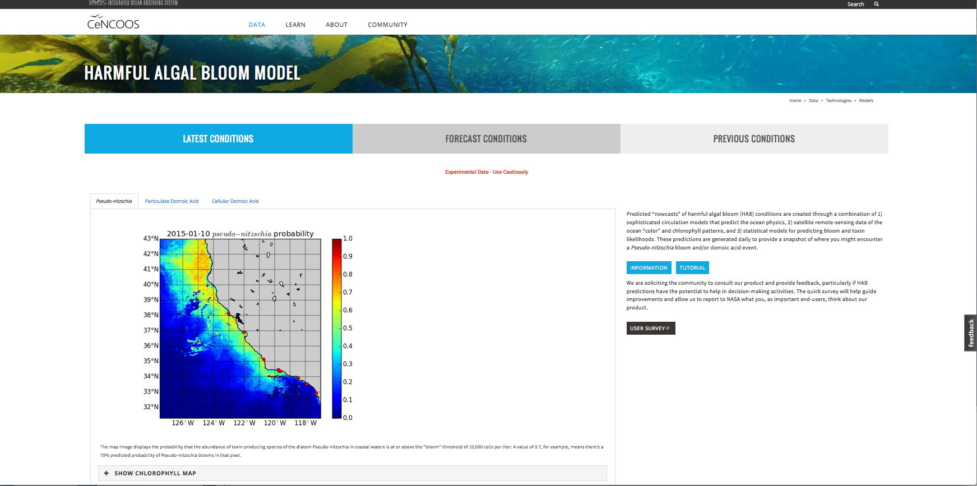
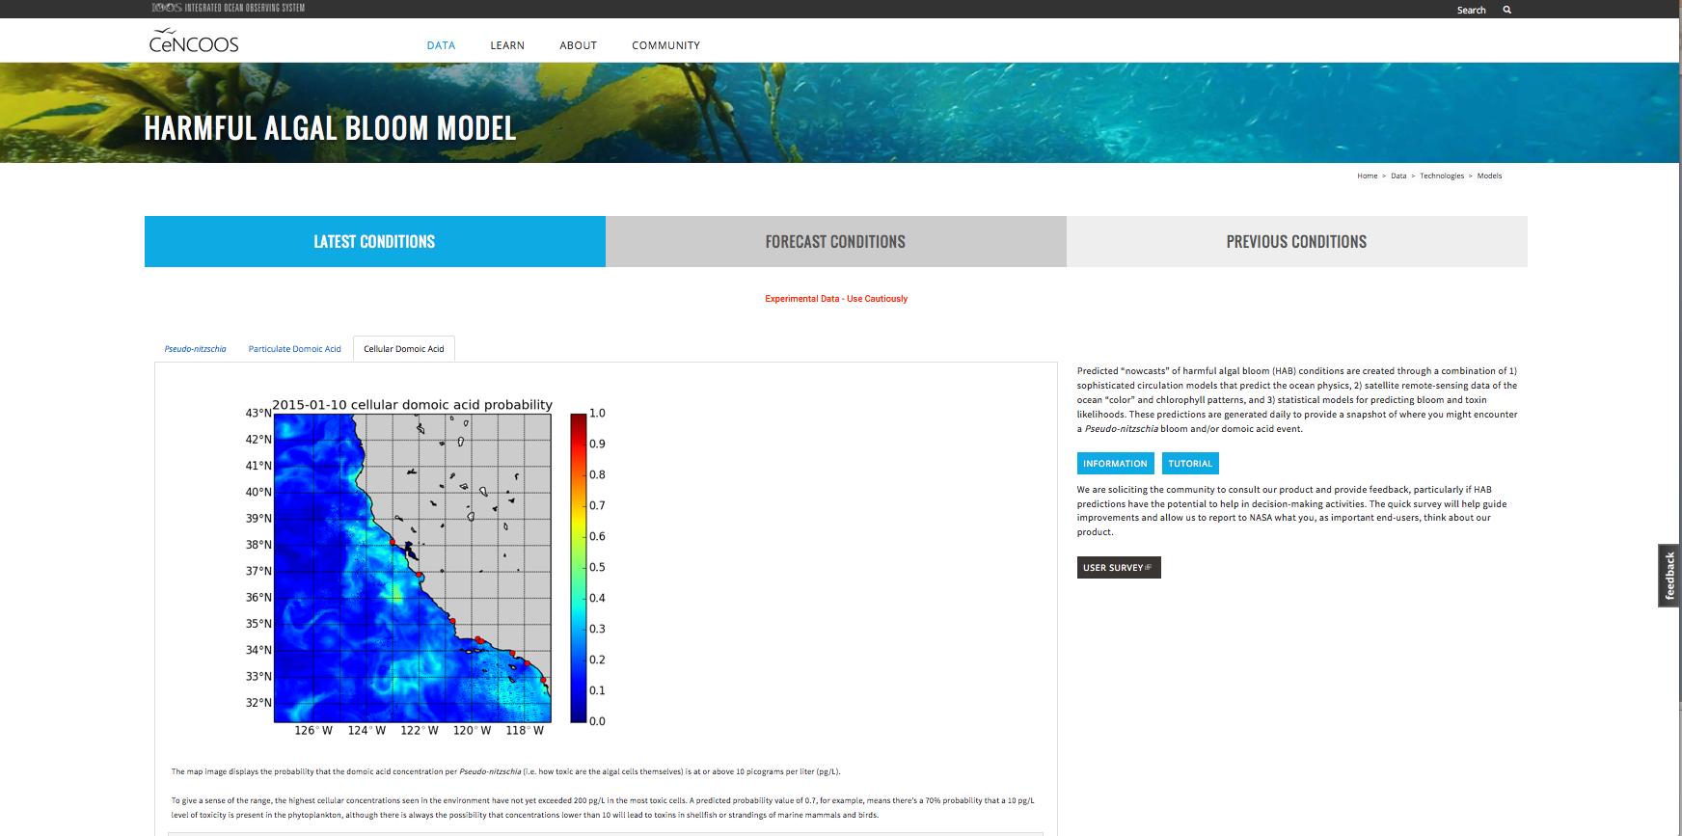
Forecasting HABs in the California Current - FEASIBILITY DEMONSTRATION
PUBLIC WEBSITE TO ENGAGE STAKEHOLDER COMMUNITY
http://www.cencoos.org/data/models/habs
HABMAP?
PSEUDOMAP?
DA-FIT
Pseudo-nitzschia
Particulate DA
Cellular DA
GOOGLE FORM
Feedback from:
Natural Resource Managers
End Users
Partner Organization
(NOAA NOS & NWS)
red points =
shore stations
CeNCOOS Fall &Winter Newsletter solicited participation from broad CA community
and to advertise use of our crowdsourcing website and mobile applications

Slide 10
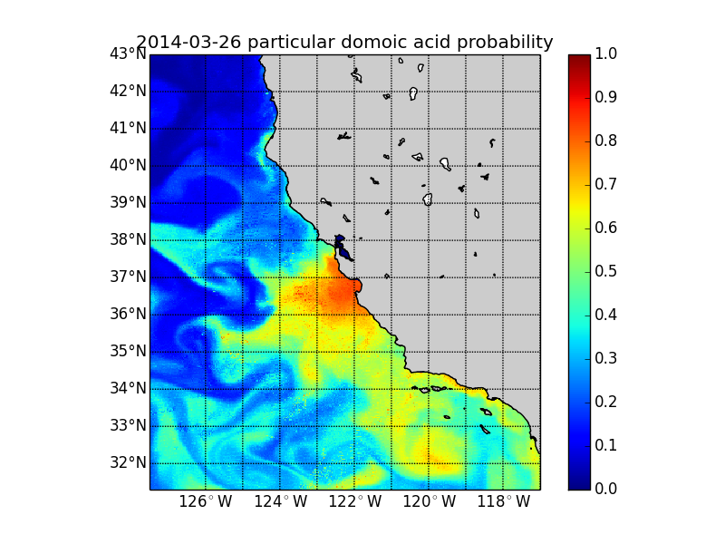
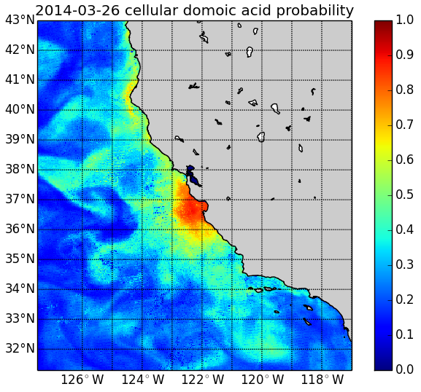
Forecasting HABs in the California Current - FEASIBILITY DEMONSTRATION
HABMAP
Shore
Stations
Santa Cruz Wharf
particulate
Nearshore
vs
Offshore
Pixel
Anderson
et al. in prep

Slide 11
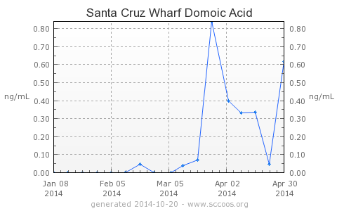
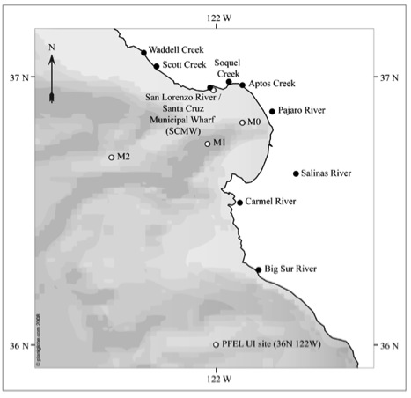
Forecasting HABs in the California Current - FEASIBILITY DEMONSTRATION
CA Sea Lions and Guadalupe seals begin to strand
Santa Cruz
Municipal Wharf
MONTEREY BAY
840 ng L⁻¹
CA State issues
anchovy & sardine
warnings in MB
Domoic Acid Predictions for March 26, 2014
particulate
Monterey Bay =
hot spot

Slide 12
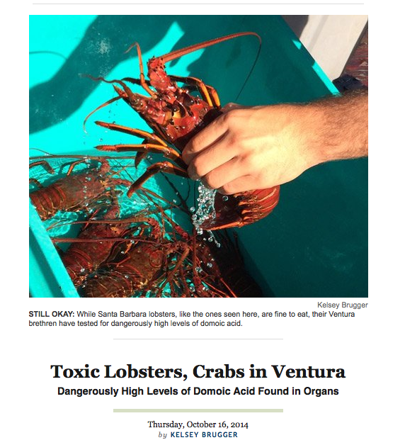
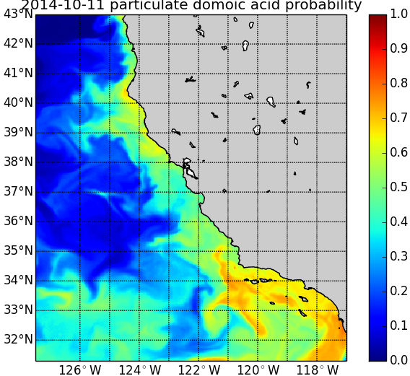
Forecasting HABs in the California Current - FEASIBILITY DEMONSTRATION
October 11, 2014
CA Dept of Public Health issues a warning
not to eat crabs, lobsters, and bivalves harvested
in the Santa Barbara Channel region,
another well known hot spot for DA
Kelsey Brugger,
Santa Barbara
Independent
Forecasted Domoic Acid Probabilities were highest in this
region on Oct 11 and remained
elevated in the Southern California Bight through Oct 21

Slide 13
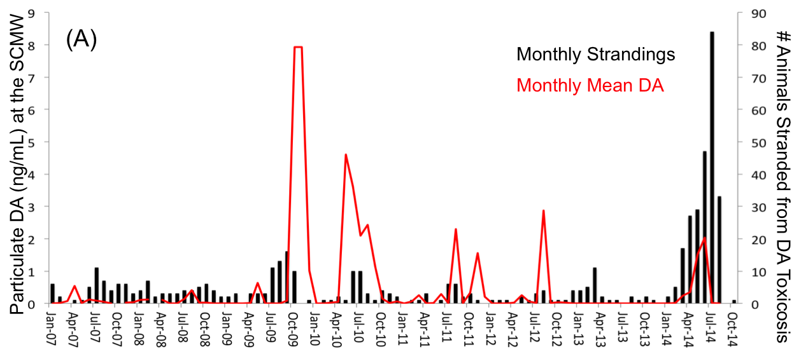
Forecasting HABs in the California Current - FEASIBILITY DEMONSTRATION
Unusual year ➔ mismatch between nearshore DA levels &
DA-related mammal strandings, June-August 2014
SC Wharf Domoic Acid
DA levels drop in June
2014 when stranding
numbers peak
Monthly Mean Strandings
for Central California*
* Data from Citizen Scientists & The Marine Mammal Center
Notes:
Marine mammal stranding events in central California that are related to DA poisoning are usually a good indicator of DA in the water… seen here from measurements taken at SC Wharf and a wharf in Santa Barbara further down the coast.
However this year, animals continued to strand with signs of DA toxicity well into June, July, and August… in RECORD NUMBERS… with little DA measured nearshore.

Slide 14
Forecasting HABs in the California Current – SKILL ASSESSMENT
DA model correlates well with the central CA stranding peaks as early as 10 days before they occur
CCF
Cross correlation function for monthly mean marine mammal strandings and the pDA model at a pixel just offshore of Santa Cruz Municipal Wharf. The modeled time series was smoothed with a 30-day running average (low-pass filter) and was not transformed prior to analysis since the autocorrelation function appeared stationary.

Slide 15
Forecasting HABs in the California Current – SKILL ASSESSMENT
Contingency Plots to Assess
Model Performance –
Optimize Prob. Threshold
Prob/Score/Ratio
Pseudo-nitzschia at the SC Wharf vs.
Nearest Model Pixel
0.68
Domoic Acid at the SC Wharf vs.
Nearest Model Pixel
Prob/Score/Ratio
ROC scores indicate utility of the models for
decision-making
0.60
Receiving Operating
Characteristic=
POD vs. POFD
Threshold

Slide 16
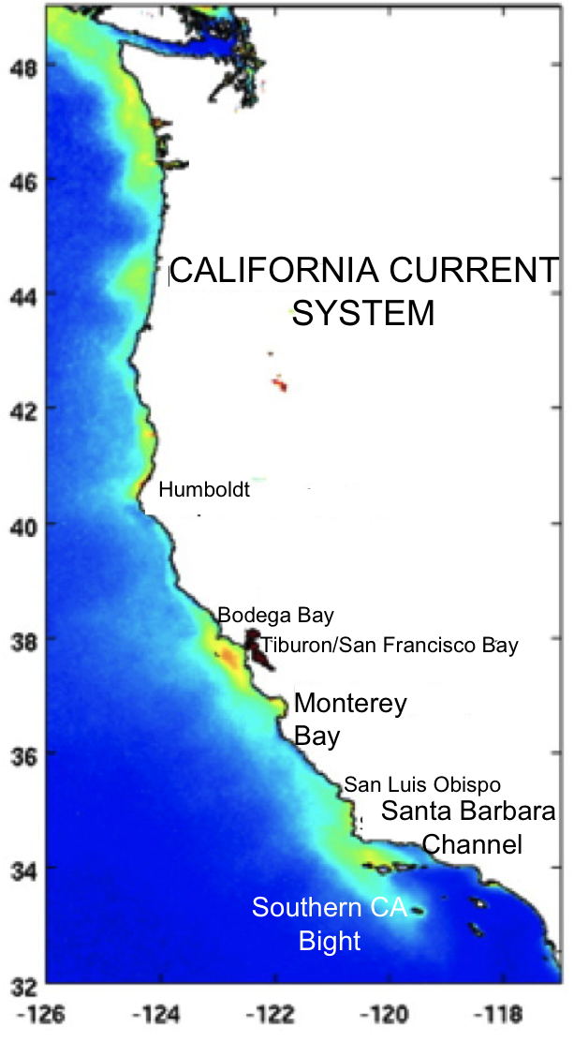
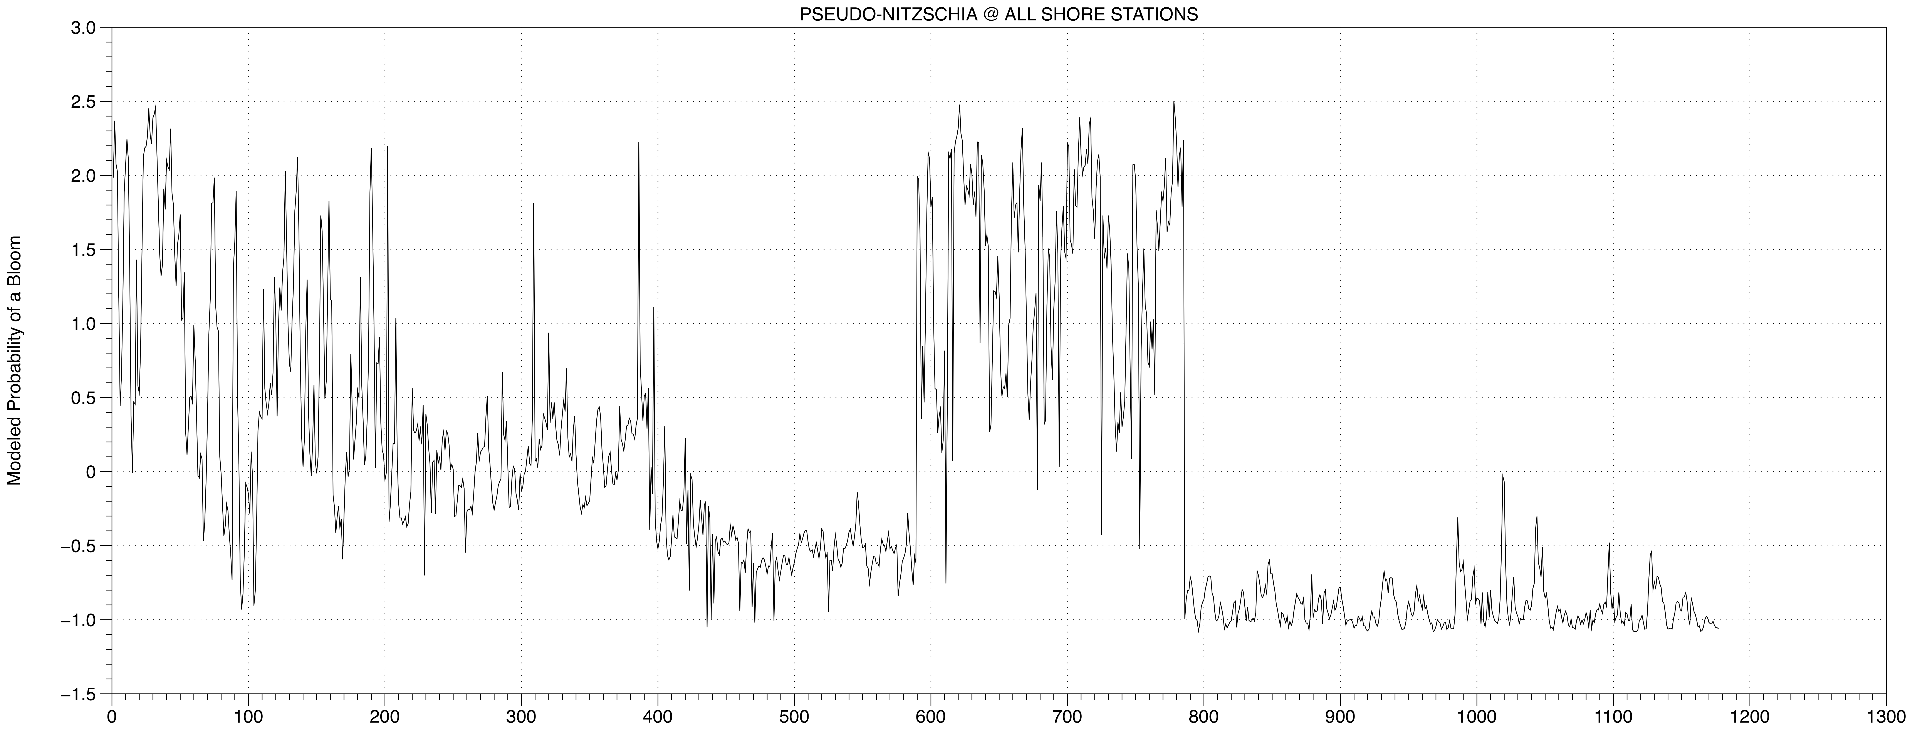
Forecasting HABs in the California Current – SKILL ASSESSMENT
Regional Variation in Model Range from N to S California….
suggests that we need regionally varying thresholds
Pseudo-nitzschia Abundance
North
South
Region 1
Region 3
Monterey Bay
to Pt. Conception
Santa Monica
Basin
Region 2
Santa Barbara
Channel
Region 4
Orange County/
San Diego
Notes:
Taken all together, the K-S test shows pretty good similarity across modeled and observed distributions (i.e. KS is below 0.5, just barely)
There’s also an obvious N to South pattern in the range of values. It appears that as many as 4 subregions exist,
1 MB to Pt Conception, (CeNCOOS domain)
2 SB Channel
3 Santa Monica Basin – Los Angeles area
4 southern portion of Southern California Bight
… which may warrant different thresholds and prediction points for assessing model performance

Slide 17
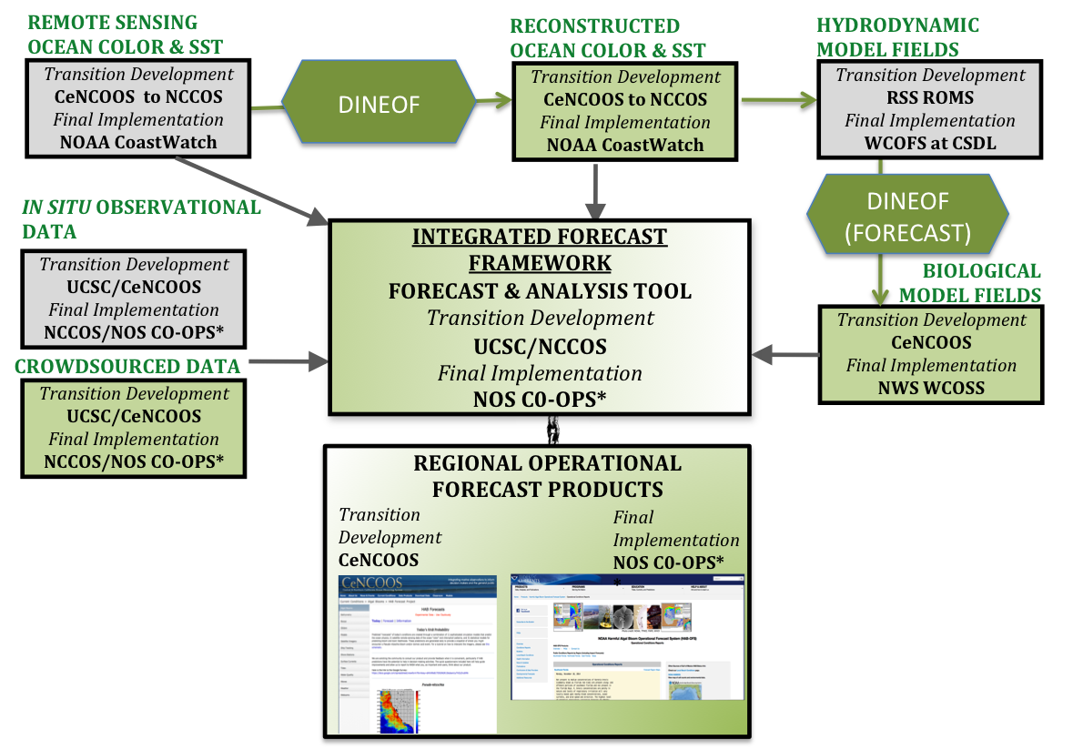
Forecasting HABs in the California Current - PARTNER/END USER ROLES
MODISA TO
VIIRS
CeNCOOS = Central and Northern California Ocean Observing System
NCCOS = National Centers for Coastal Ocean Science
CSDL = Coast Survey Development Lab
RSS = Remote Sensing Solutions, Inc.
WCOFS = West Coast Operational Forecast System
WCOSS = Weather and Climate Operational Supercomputing System
CO-OPS = Center for Operational Oceanographic Products & Services

Slide 18
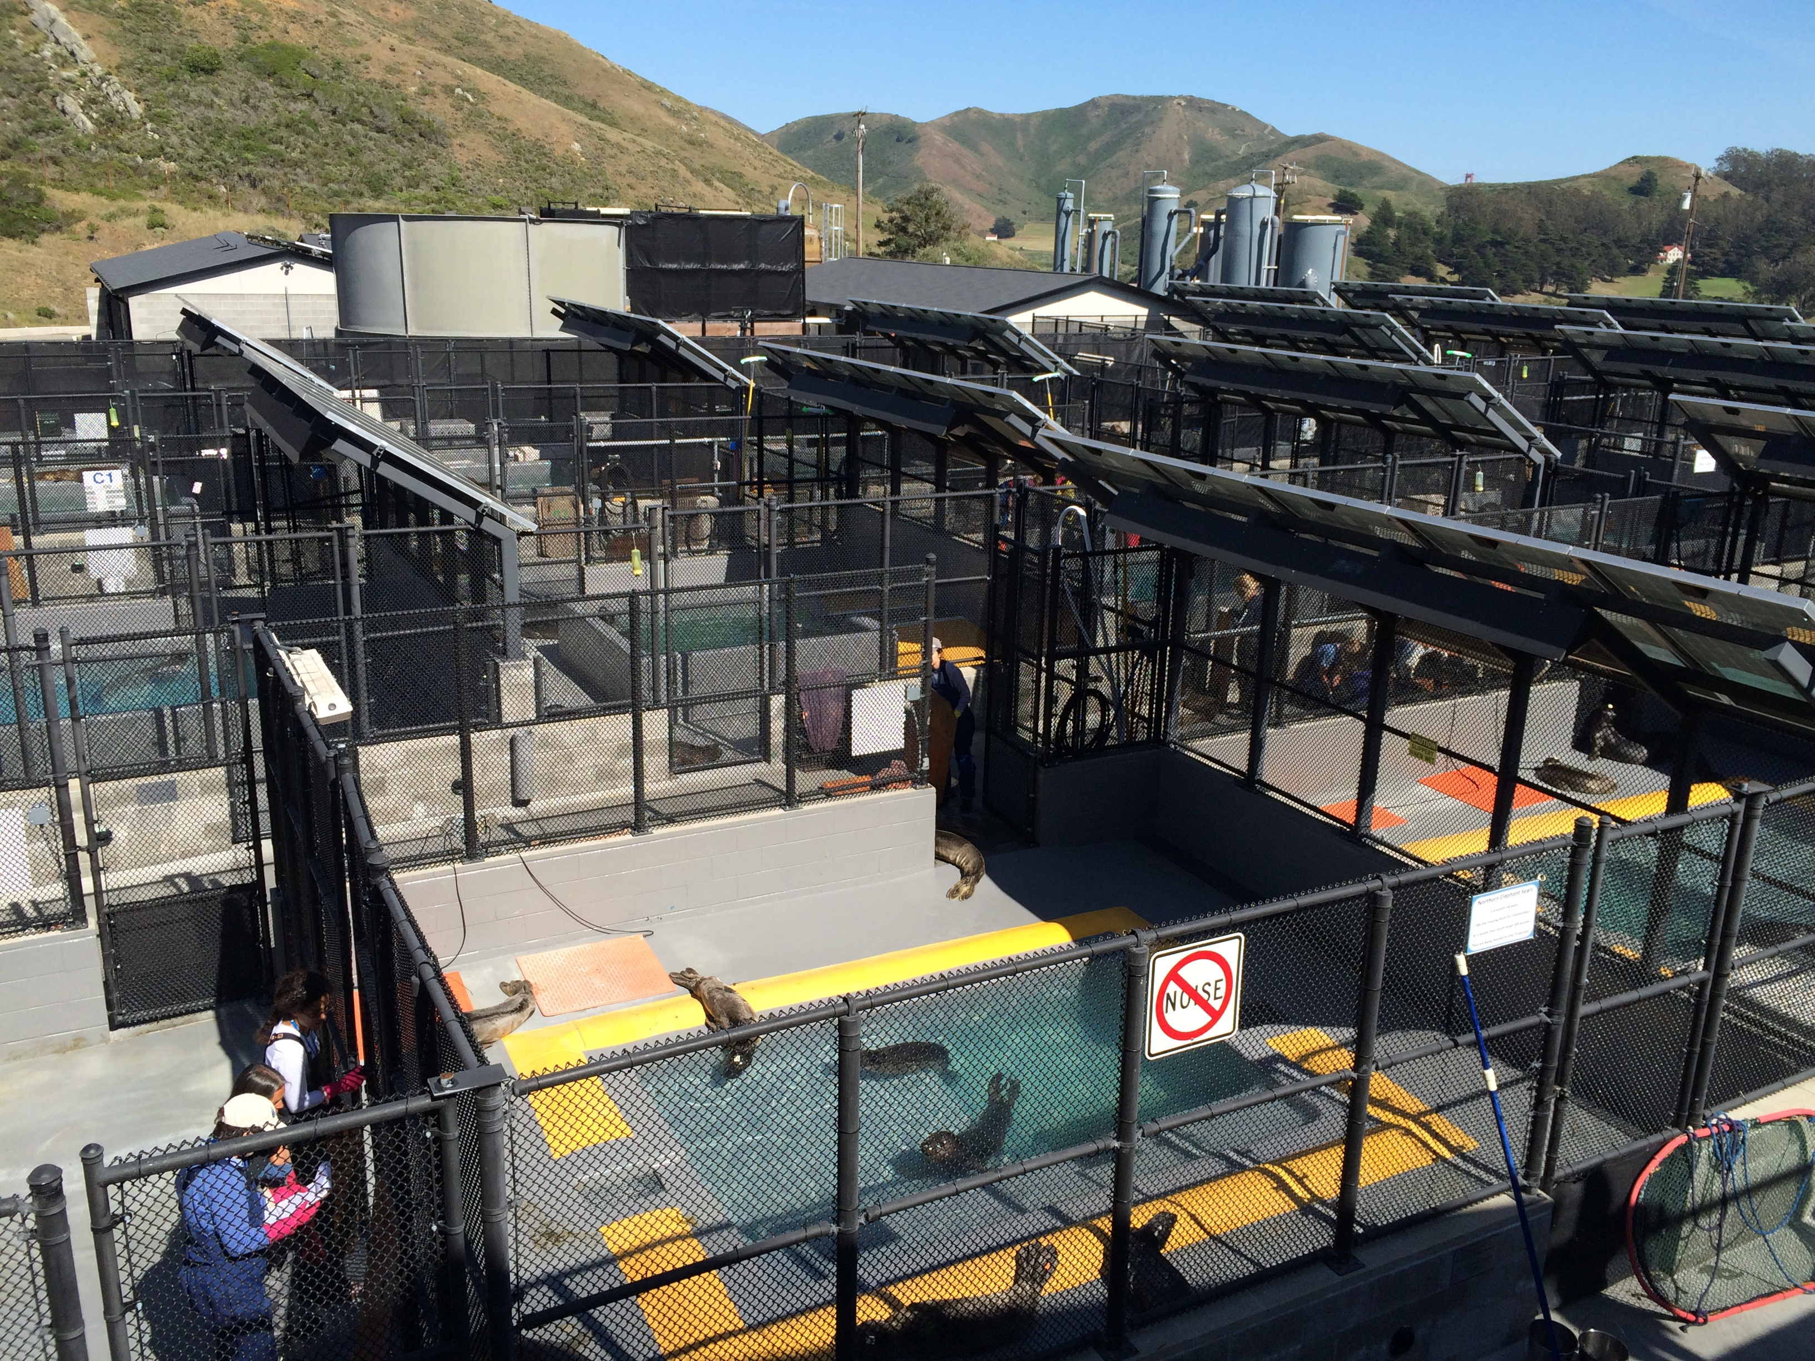
THANK YOU
Award #NNX14AC42G

Slide 19
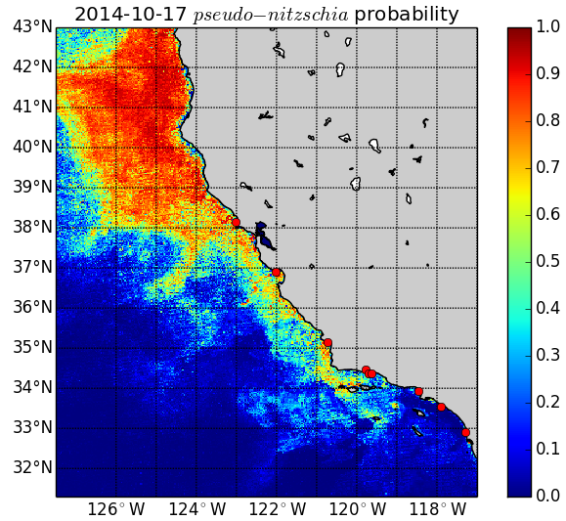
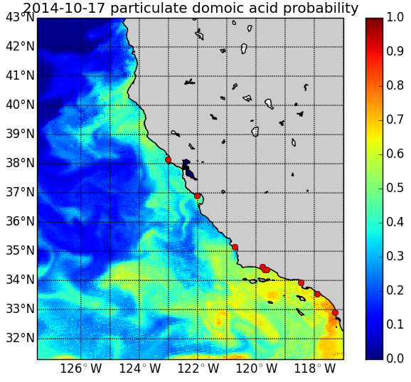
PHASE 1. FEASIBILITY DEMONSTRATION
October 17, 2014
Monterey Bay – NSF UNOLS Chief Scientist Training Cruise
Offshore measurements show elevated Pseudo-nitzschia abundance but low DA concentration
Kelsey Brugger,
Santa Barbara
Independent
~5,000
cells L⁻¹
<10 ng L⁻¹

Slide 20

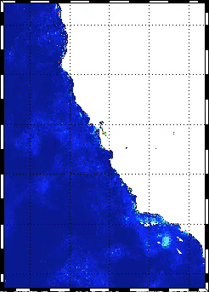
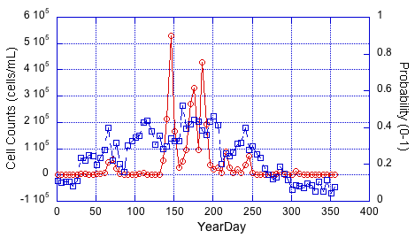
Forecasting HABs in the California Current - TECHNOLOGY
DINEOF - HINDCASTING Pseudo-nitzschia
Probability of Pseudo-nitzschia,
5-day intervals,
2009
Red: Cell Counts
Blue: Predicted Probability
2009 Hindcast versus Cell Counts, Santa Barbara
• Focus on 2009 (Anderson et al. 2011)
• DINEOF reconstruction at 5-day intervals

Slide 21
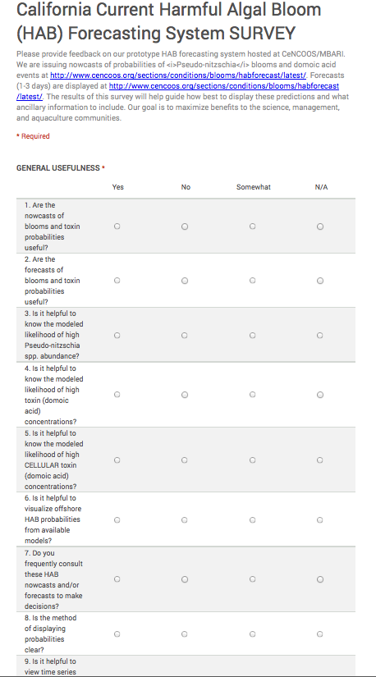
PHASE 1. ENGAGING STAKEHOLDERS, PARTNERS, & END USERS
SURVEY TO ADDRESS USER NEEDS
Nine questions addressing the overall utility of the application to decision-making
Request for comments and feedback to improve the application or its visualization
We received feedback from aquaculture, marine mammal rescue organizations, and public health managers indicating the application is useful, provides decision support, and is a marked and necessary improvement over the baseline (i.e., no early warning system for domoic acid).
Forewarning allows managers to optimize monetary & human resources;
accurate quantification of those cost savings is more challenging
“If we determine that a broad region, say Santa Barbara and Ventura counties, respond similarly under a certain threshold probability for Pseudo-nitzschia, we would have the ability to focus increased sampling effort for toxins.”
-Gregg Langlois, CA Dept of Public Health

Slide 22
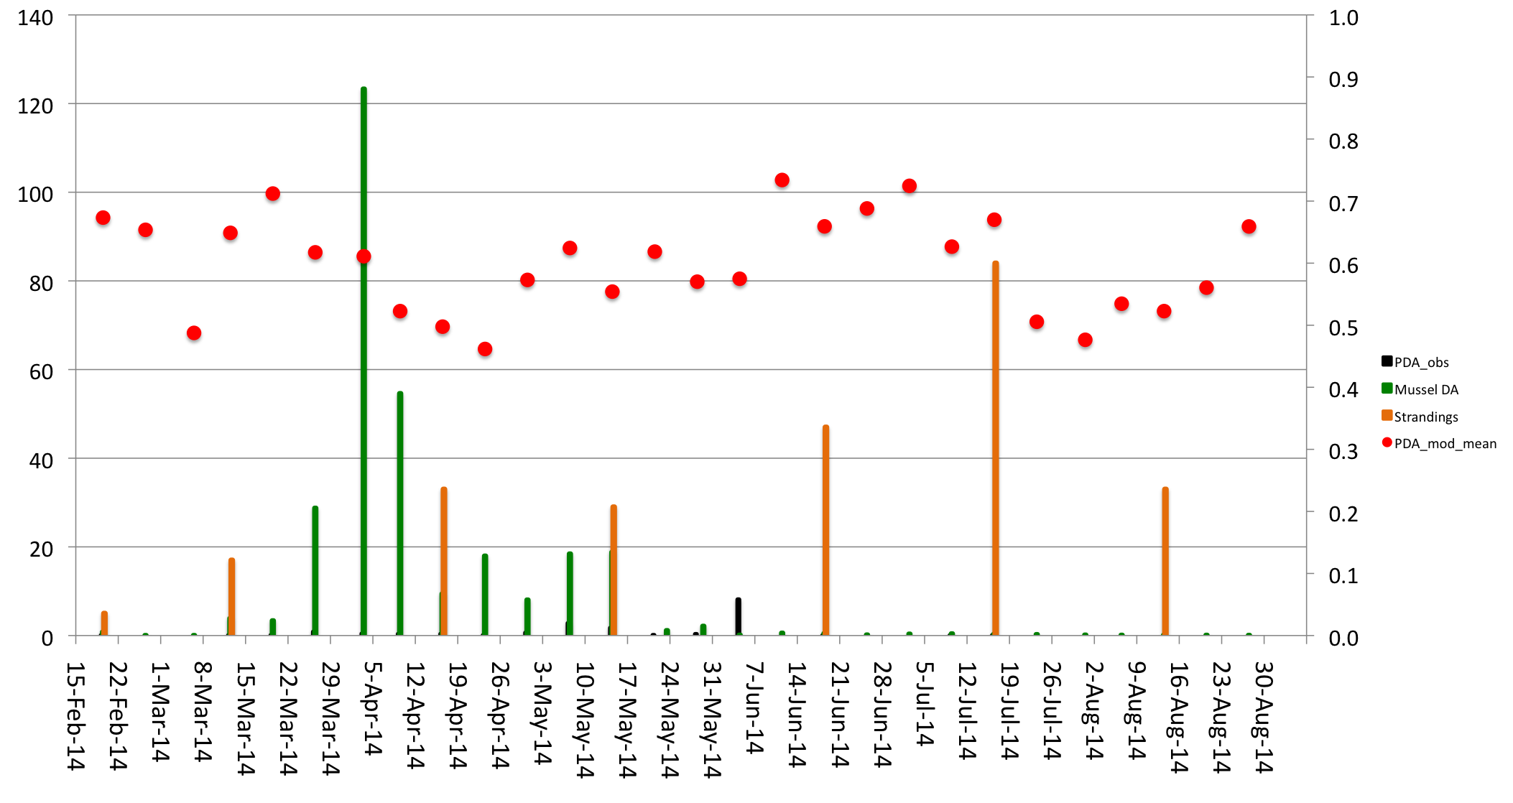
PHASE 2 . SKILL ASSESSMENT – MODEL vs. CROWDSOURCED OBSERVATIONS
SC Wharf Domoic Acid
Forecasted Domoic Acid
(running mean at SC Wharf pixel)
Mussel Domoic Acid
Monthly Mean Strandings
for Central California
Citizen Scientist Stranding Obs
(= 1 marine mammal) *S. Haddock
Optimized Pred. Pt. = 0.6
No. of Marine Mammal Strandings
Domoic Acid (μg L⁻¹)
Modeled Probability of a DA Event
reg. limit = 20 μg/g

Slide 23

PHASE 1. ENGAGING THE PARTNER ORGANIZATION
MEASURING FEASIBILITY-PHASE BENEFITS TO OUR END USERS
Met with NOS liaison Rick Stumpf twice to develop a Phase 1 Plan
Multiple phone conversations with Rick Stumpf and David Green
(formerly at NWS) throughout Phase 1 to ensure future integration
Metrics for Feasibility Assessment:
Forecast & Analysis Tool ☐
  -being developed in close partnership with NOAA NOS, on-going (Phase 2)
User/Satisfaction Feedback ☑
HAB Forecast Skill Assessment ☑
-incorporates crowdsourced observations of marine mammal strandings
4) Accuracy and Optimization of the DINEOF Fields ☑
5) Successful merger of DINEOF and ROMS output for forcing
HAB model predictions ☑

Slide 24
PHASE 2 . DEVELOPMENT CHALLENGES
STRENGTHS & WEAKNESSES OF OUR APPROACH
1
2
Interpolated satellite images
(and error estimates)
2-D MODIS IMAGERY
3-D ROMS 3-day Forecast
3
wget MODIS files
(OBPG subscription);
l2gen – Python/SeaDAS routine to process L1 to L2
Script to grab ROMS SST and SSS forecasts from RSS data portal;
averaging 4-hr runs to get daily value
Running DINEOF on L2 netCDF files on ROMS model domain
(351 x 391 x time)
1) Flag files containing
ZERO values
2) Issue with THREDDS server at RSS; intermittency of data acquisition due to only partial download of “latest” cached file; using Wireshark to track packets and determine a solution
Potential difficulty with Python subprocess (gpt.sh) to extract region and
bands of interest
DINEOF on parent grid (1008 x 1124 x time) is often the rate-limiting step; improvement likely if DINEOF is compiled on Linux (preferrably Ubuntu), but NOTE: compile is little-endian while the test files are native (must change parameter file to indicate the endianness being used)
4
HAB NOWCASTS
Compute the statistical models (GLM)
for Pseudo-nitzschia blooms and DA toxicity; write PNG files to “today” directory
5
HAB FORECASTS
Model re-tuning of coefficients to fit updated in situ data is problematic;
best to designate a system UPDATE when all models are re-evaluated with new predictors and new coefficients to ensure best-fit models
Compute rate of change for u and v velocities to advect points forward one to three time steps; write PNG files to separate forecast directories for Pseudo-nitzschia, particulate DA, and
cellular DA
Nowcast routine calls a forecast subroutine for computational time management

Slide 25
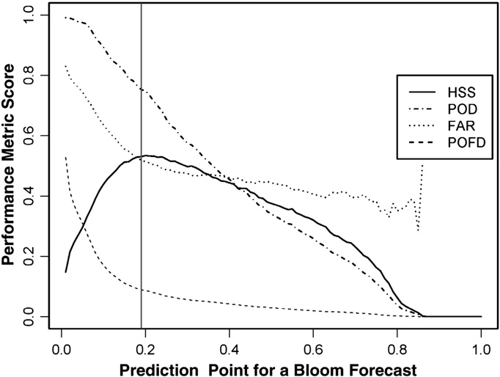
PHASE 2 . SKILL ASSESSMENT – MODEL vs. HAB MONITORING OBSERVATIONS
MODEL PERFORMANCE METRICS
DA threshold for defining a toxic event =
originally set at 500 ng L⁻¹
Probability threshold for designating
when managers should care….
Depends on how we balance detection ability,
false alarms, and overall model skill.
Statistics for Point Comparison at SC Wharf | Prob. of Detection | False Alarm Ratio | Prob. of False Detection | Heidke Skill Score | Overall Accuracy
Default Prediction Point = 0.5 DA thresh = 500 ng/L | 100% | 76% | 70% | 27% | 43%
Optimized Prediction Point = 0.6 DA thresh = 500 ng/L | 80% | 75% | 52% | 26% | 54%

Slide 26
PHASE 2 . SKILL ASSESSMENT – MODEL vs. HAB MONITORING OBSERVATIONS
DA threshold for defining a toxic event =
RELAXED TO PRESENCE/ABSENCE OF DA
Probability threshold for designating
when managers should care….
Depends on how we balance detection ability,
false alarms, and overall model skill.
Statistics for Point Comparison at SC Wharf | Prob. of Detection | False Alarm Ratio | Prob. of False Detection | Heidke Skill Score | Overall Accuracy
Default Prediction Point = 0.6 DA thresh = 500 ng/L | 80% | 75% | 52% | 26% | 54%
Optimized Prediction Point = 0.6 DA thresh = presence/absence | 59% | 38% | 55% | 74% | 54%

Slide 27

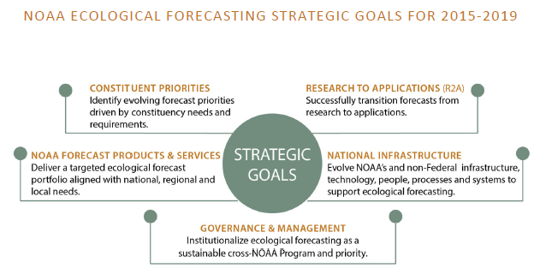

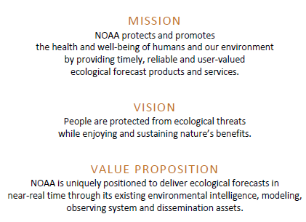
PHASE 2 . PARTNER/END USER ROLES

Slide 28
EFR HAB Goals
  Develop a standardized and modular data integration for analysis, production and dissemination of HAB forecasts on a national scale
  Ensure maintenance of existing operational HAB Forecasts, and improve through validation and refinement;
  Transition existing HAB forecasts from R&D and demo phases to operations;
    operational forecasts in Gulf of Maine, Gulf of Mexico (FL, TX), Chesapeake Bay, Lake Erie, PNW, California;
    Progress towards establishing operational systems in NY (Long Island Sound), Alaska, Caribbean, other regions
    Capacity for National Forecast and Early Warning for Event Response to HABs
  Build national infrastructure to support HAB forecast system, including advancing HAB detection capabilities

Slide 29
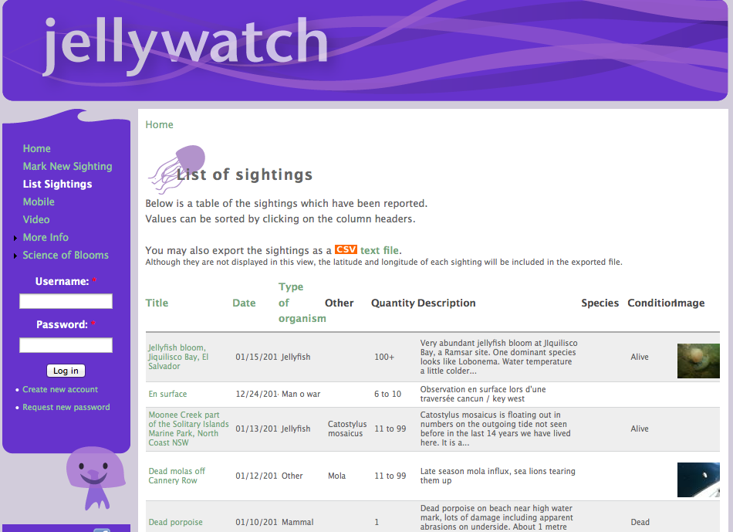
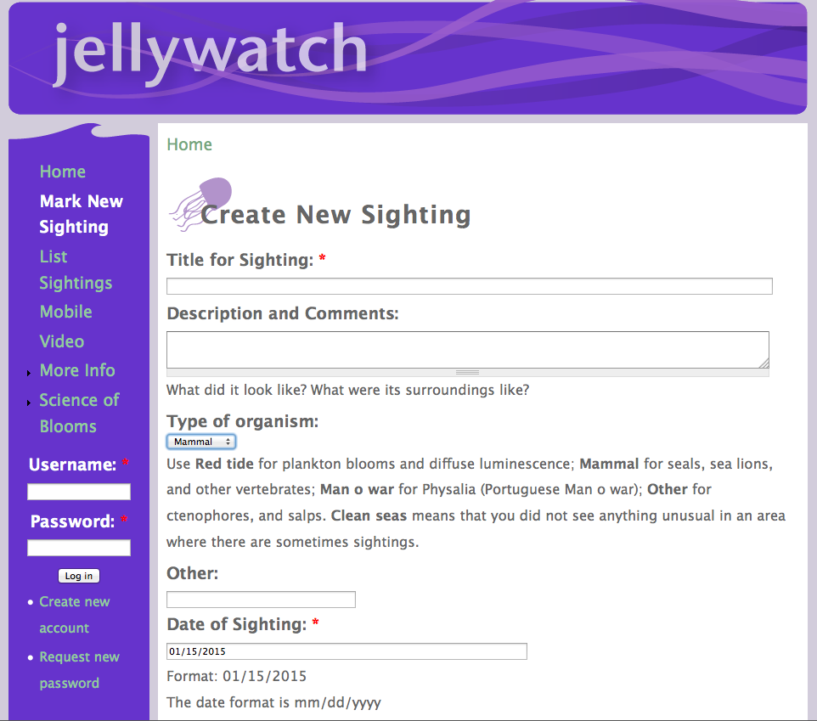
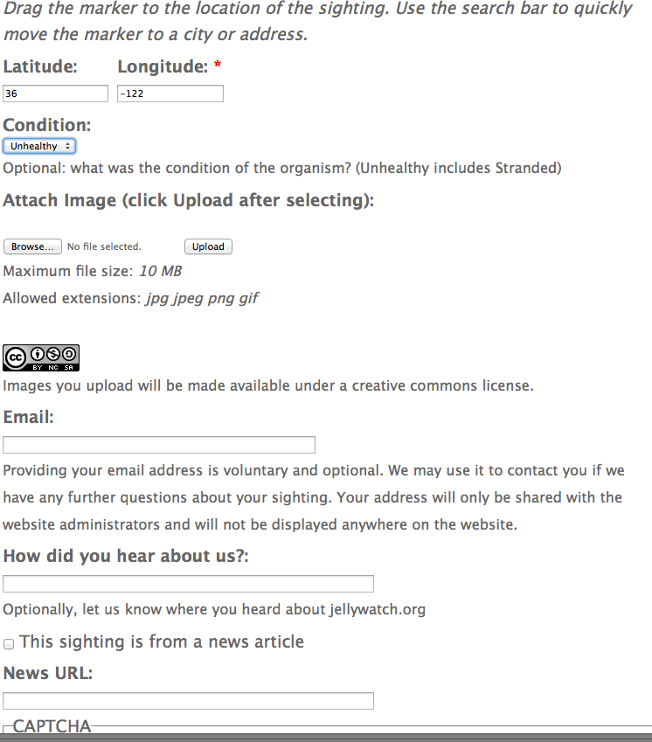
PHASE 1. ENGAGING STAKEHOLDERS, PARTNERS, & END USERS
CROWDSOURCING -RECRUITING OBSERVATIONS OF MARINE MAMMAL STRANDINGS
c/o S. Haddock, MBARI

